Slide 1
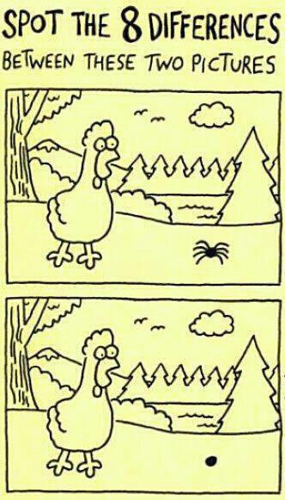
Topic: Number
EQ: How do I add and subtract decimals?

Slide 2
BUT FIRST…
Let’s review what we did last lesson.
Turn to the last set of notes we did.
You have 1 minute 38 seconds to talk to your shoulder partner about what we did.
Let’s brainstorm…
Are your notes complete? Do you need to add anything? Add extra information in a different colour.
Do you have a summary? If not, try to come up with a sentence to explain it.
Add the topic and EQ to your contents page.

Slide 3
EQ: How do I add and subtract decimals?
__/02/2019
STARTER:
56 - 21 2) 60+ 37 3) 600 – 84 4) 1200 + 95
Keywords: Sum, place values, decimal, adding, subtracting, column method.

Slide 4
What number goes with the following to make 10?
5.5
4.2
4.5
5.8
3.7
6.3
8.6
1.4

Slide 5
What decimal goes with these to make 1 ?
0.41
0.91
0.59
0.09
0.35
0.65
0.82
0.18

Slide 6
What method could you use to solve these questions?
1.7 + 1.577 =
31.745 - 1.75 =
Hint!
How are you going to set out the numbers.
What do you need to remember?

Slide 7
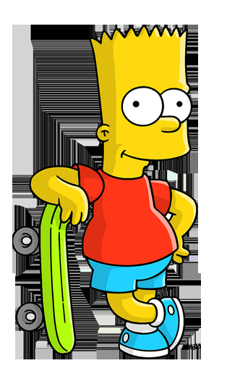


Here’s the question!
3.9156 + 3.99 =
I am right.
I have lined all the numbers up.
I am right.
My decimal place is in a line and all my numbers are in column.
3 . 9 1 5 6
3.9 9
3 . 9 9
3 . 9 1 5 6
3 . 9 1 5 6
Doh! I don’t have a clue what to do next?!
3 . 9 9

Slide 8
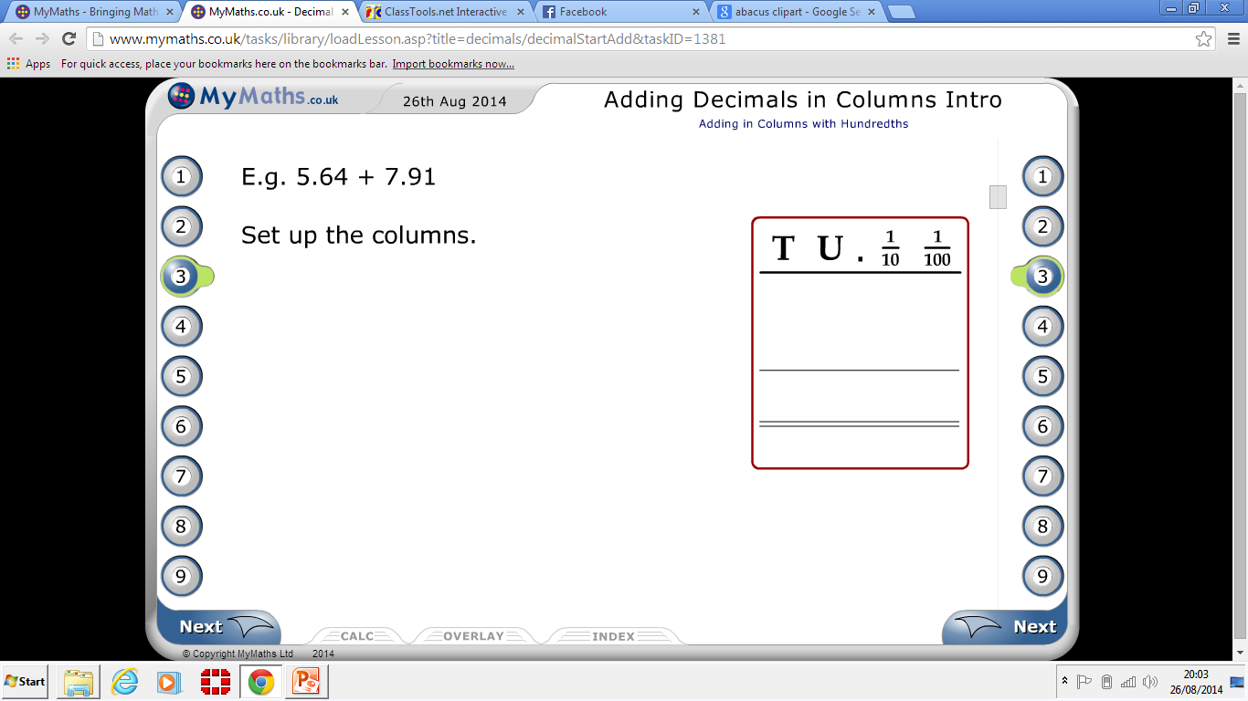
Examples:
1) 17. 5 + 6
2) 21.9 – 8

Slide 9
You try these:
13.5 + 5
7.79 - 3
34.6 – 10
12 + 5.8
18. 2 – 3.14
Extension:
11.2 + 0.7
9 – 0.15

Slide 10
Answers:
13.5 + 5 = 18.5
7.79 – 3 = 4.79
34.6 – 10 = 24.6
12 + 5.8 = 17.8
18. 2 – 3.14 = 15.06
Extension:
11.4 + 0.7 = 12.1
9 – 0.15 = 8.85

Slide 11
Answers:
1. Carla bought a CD for $4.65 and some sweets for $2. What is the total cost? $6.65
2. Peter is re-wiring his house. For upstairs he needs a length for 6.8m, for downstairs he needs a length of 10m. Work out the total length that Peter needs? 16.8m
3. Jim bought a magazine for $2.65. How much change did he get if he paid for it with a $5 note? $2.35
4. In a year, Sarah's weight (mass) decreased from 48.2 kg to 45 kg. How much weight did she lose in the year? 2.8kg
5.A big bar of chocolate costs 95c, 3 small bars of chocolate costs $1.35, Work out the difference between these two prices? 40c

Slide 12
6. A sunflower plant is 1.47 m tall at the start of the week. It is 2m tall at the end of the week. How many cm did it grow during the week?
0.23 m
7. Sarah used 34.5g of sugar to make a cheesecake and 9g to make a lime pie. How many grams of sugar has Sarah used? 43.5g
8. A calculator costs $2.99, an eraser costs 25c and a ruler costs 45c, how much do they cost in total? $3.70 ($3.69 but we need to round to the nearest 5c)
9. A large bottle of juice weighs 38.7g, the bottle itself weighs 5.1g. How much does the juice itself weigh? 33.6g
10. Olly bought 350ml of orange juice in bottle, he drank 121.15ml of that. How much orange juice was left in the bottle? 228.85ml

Slide 13
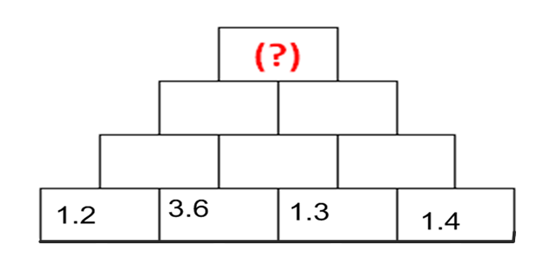
Activity: Decimal Pyramid
Find the (?) in this addition pyramid.
Remember: To find each brick add the two bricks directly below it

Slide 14
Examples:
1) Jerry has $13.7 and Jenny has $8, how much do they have altogether?
2) Holly went shopping with $24.05 in her purse. She spends $6 on a make up bag. How much does she have left?

Slide 15
Plenary:
Jason has a $5 note when he leaves home. He spends 25c on sweets in one shop and $3.50 on a book in another shop. How much money does he have left?

